Slide 1



Digital Electronics
Class X
lab 18

Slide 2
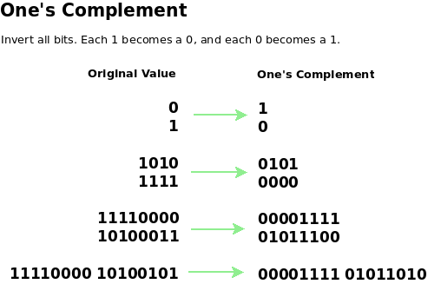
1’s complement
transforming the 0 bit to 1 and the 1 bit to 0

Slide 3
1’s complement Examples
1's complement of 7 (0111) is 8 (1000)
1's complement of 12 (1100) is 3 (0011)

Slide 4
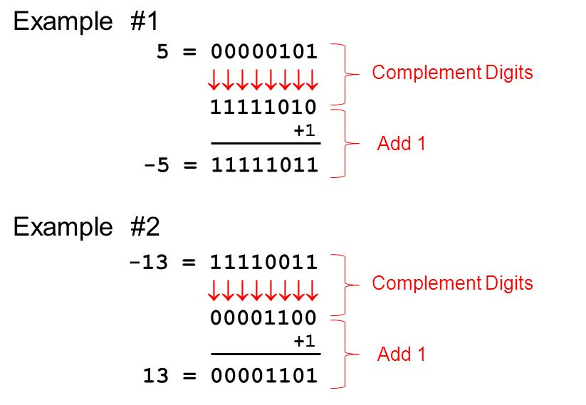
2’s complement Examples
1 is added to the 1’s complement of the binary number

Slide 5
Differnce

Slide 6
Thank You

